Slide 1

SMART INDIA HACKATHON 2026
TITLE PAGE
Problem Statement ID- SIH26189
Problem Statement Title- AI-Powered Criminal Network Analysis System
Theme- Blockchain & Cybersecurity
PS Category- Software
Team ID-
Team Name- Gits N’ Roses

Slide 2
IDEA TITLE
Gits N’ Roses
Proposed Solution (Describe your Idea/Solution/Prototype)
The Problem:
Criminal networks today are organized and interconnected — spanning associates, financial channels, communication links, and locations. Law enforcement has the data to catch them, but it's scattered across seven disconnected sources:
FIRs & police reports
Call Detail Records (CDRs)
Financial transaction records
Surveillance reports
Social media intelligence
Criminal history databases
Intelligence agency reports
The result: fragmented, unstructured data across multiple systems → slow, manual, error-prone analysis → critical connections get missed.
How it addresses the problem: Investigators currently rely on manual cross-referencing of thousands of documents, which is slow and misses connections. Our system automates entity extraction and relationship discovery, surfacing hidden links and ranking individuals by network importance — cutting investigation time and reducing missed connections.
Detailed explanation:
Collect and process data from multiple sources
Extract important entities: people, locations, vehicles, phone numbers, organizations
Build relationship maps showing how entities are connected
Identify key individuals who play influential roles in the network
Detect suspicious patterns and unusual activities
Provide visual and analytical insights to investigators
Innovation/uniqueness: Combines pretrained NLP (spaCy) for entity extraction with graph theory (NetworkX centrality algorithms) for influence scoring, delivered through an interactive visual dashboard rather than requiring investigators to read raw reports.

Slide 3
TECHNICAL APPROACH
Gits N’ Roses
Technologies to be used:
Methodology / process flow:
Tool | Purpose
Python | Core language connecting the pipeline
spaCy | Named entity extraction (NER)
Regex | Catches phone numbers, plates
NetworkX | Graph building + centrality analysis
PyVis | Interactive graph visualization
Streamlit | Dashboard/UI
Data sources
Mock FIRs, CDRs, call records, reports
Text preprocessing
Extracts people, locations, orgs (spaCy)
Graph construction
Builds entity relationship graph
Network analysis
Centrality scores identify key players (NetworkX)
Dashboard & visualization
Interactive graph view (Streamlit + PyVis)

Slide 4
FEASIBILITY AND VIABILITY
Gits N’ Roses
Feasibility: High for a working prototype — every pipeline stage uses a mature, pretrained, or well-documented library (no custom model training required), making it buildable within a short timeline.
Challenges identified: Real-world crime data is far messier than clean mock data (typos, regional language, inconsistent formats) Co-occurrence-based connections can produce false positives (two people mentioned together without an actual criminal link)Entity disambiguation (same name referring to different people) isn't handled by default NERSolo/independent criminals with no shared connections are harder to flag through pure network analysis
Mitigation strategies: Position the system as investigator decision-support, not an automated accusation tool — final judgment stays humanCombine co-occurrence with stronger signals (shared phone numbers, locations) to reduce false positivesExtend the model with anomaly/frequency-based detection to also catch solo actors, not just networked onesPlan a human-in-the-loop verification step before any flagged connection is acted on

Slide 5
IMPACT AND BENEFITS
Gits N’ Roses
Impact on target audience: Reduces investigator time spent manually cross-referencing records; surfaces hidden connections that manual review would likely miss; helps prioritize which individuals to investigate first.
Social/governance benefit: Supports NCRB's broader goal of faster, more data-driven crime investigation; can be extended to support women's safety casework (given the Women Safety Division context) by surfacing repeat-offender patterns across cases.
Economic/scalability benefit: Built on open-source, low-cost tools — no expensive proprietary software or large-scale ML infrastructure needed to deploy at a department level.

Slide 6
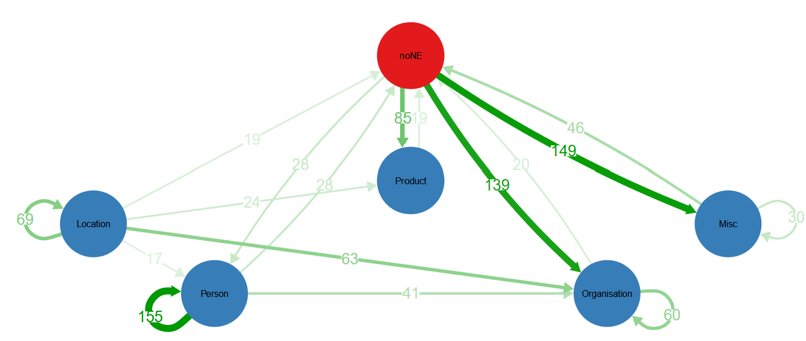
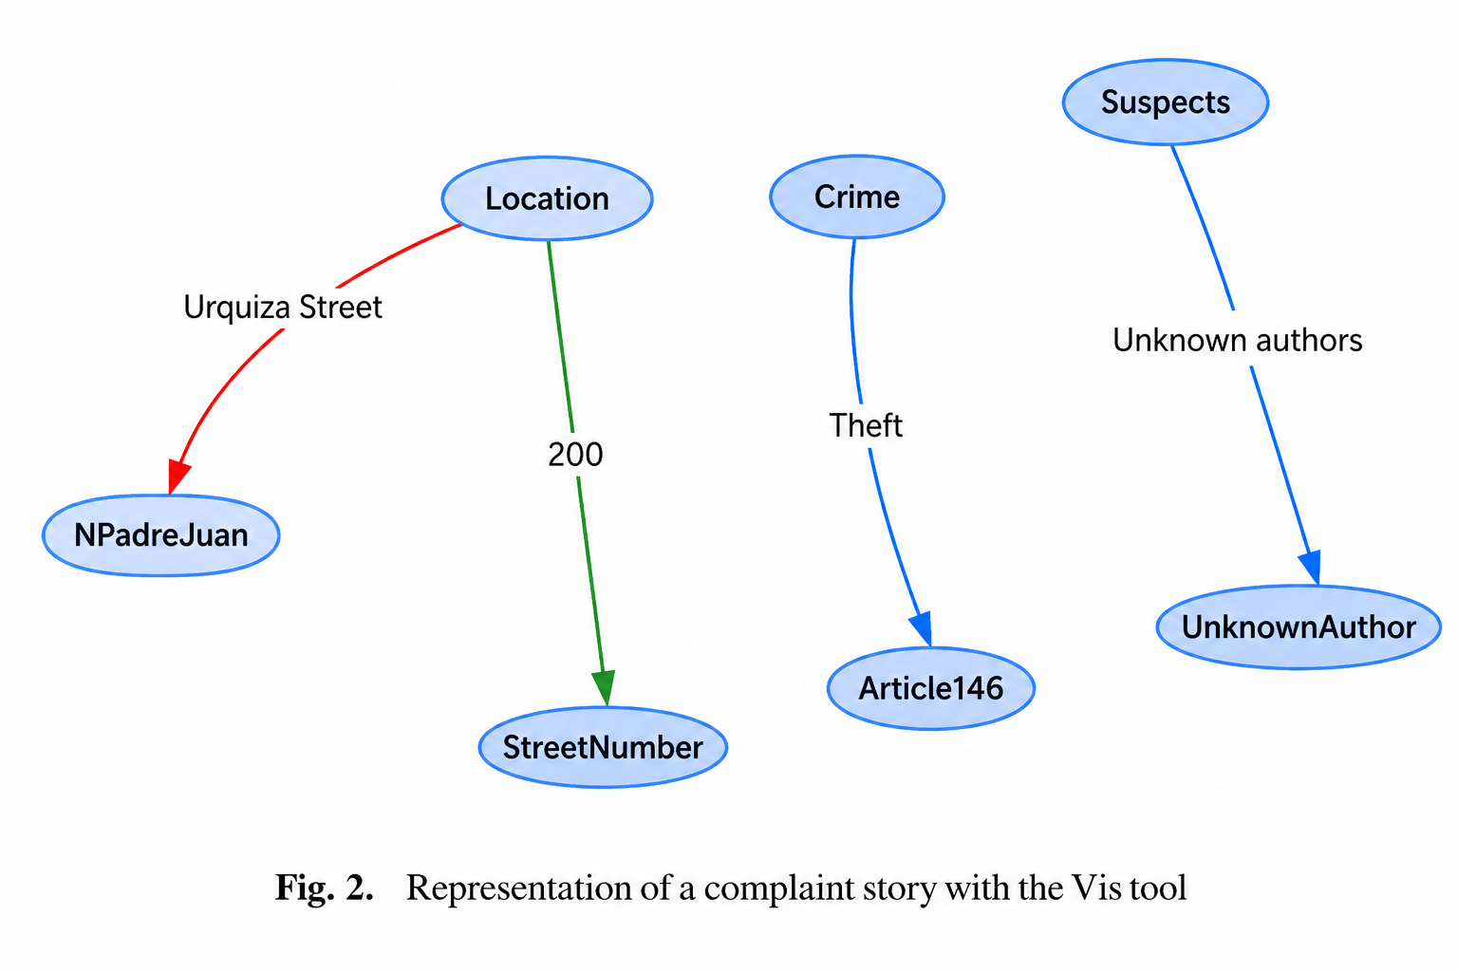
RESEARCH AND REFERENCES
Gits N’ Roses
Schraagen et al. (2017) confirm NER is effective on real police complaint text but identify systematic recall/confusion errors — a limitation our system acknowledges and would need to address with domain-specific fine-tuning in production.
Graph showing type confusion between types recognised by the algorithm and manually
assigned types. The full confusion table is included in the Appendix.
https://dspace.library.uu.nl/bitstream/handle/1874/356185/01.NERclinjournal.pdf?sequence=1
Álvarez & Antonelli (2024) apply spaCy-based NER to police complaints to automatically generate link maps between related cases — validating the core NER-to-graph approach our system extends with network-wide centrality analysis.
Representation of a complaint story with the Vis tool
https://digital.cic.gba.gob.ar/server/api/core/bitstreams/6bdf5e45-2f17-4db6-af51-062abafe4743/content

Slide 7
IMPORTANT INSTRUCTIONS
Please ensure below pointers are met while submitting the Idea PPT:
Kindly keep the maximum slides limit up to six (6). ( Including the title slide)
Try to avoid paragraphs and post your idea in points /diagrams / Infographics /pictures
Keep your explanation precise and easy to understand
Idea should be unique and novel.
You can only use provided template for making the PPT without changing the idea details pointers (mentioned in previous slides).
You need to save the file in PDF and upload the same on portal. No PPT, Word Doc or any other format will be supported.
Note - You can delete this slide (Important Pointers) when you upload the details of your idea on SIH portal.

